Slide 1
Introduction to Dynamic Programming
Elite FS
Sweta Vooda

Slide 2

What is Dynamic Programming?
Optimization over plain recursion

Slide 3








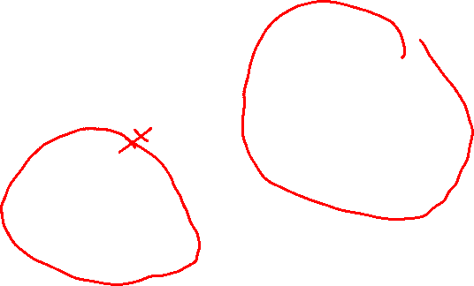

Example: Fibonacci series
static int fib(int n)
{
if (n <= 1)
return n;
return fib(n - 1) + fib(n - 2);
}

Slide 4
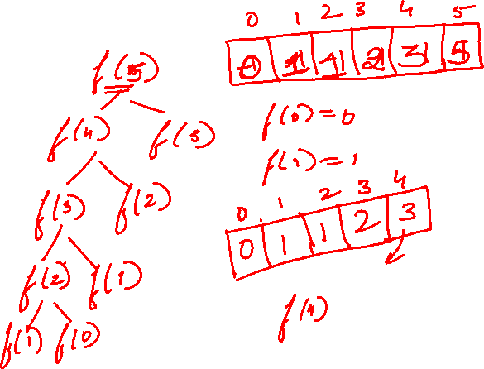
Methods to store values
Memoization (Top Down)
Tabulation (Bottom Up)

Slide 5
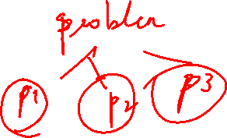
Conditions for Dynamic programming
Overlapping Subproblems
Optimal Substructure
Notes:
In contrast to divide and conquer algorithms, where solutions are combined to achieve an overall solution, dynamic algorithms use the output of a smaller sub-problem and then try to optimize a bigger sub-problem. Dynamic algorithms use Memoization to remember the output of already solved sub-problems.

Slide 6
Greedy vs DP
 | Greedy | Dynamic Programming
Feasibility | make choice that seems best at the moment in the hope that it will lead to global optimal solution. | make decision at each step considering current problem and solution to previously solved sub problem to calculate optimal solution .
Optimality | sometimes there is no such guarantee of getting Optimal Solution. | It is to generate an optimal solution as it generally considers all possible cases and then choose the best.
Memorization | It is more efficient in terms of memory as it never look back or revise previous choices | It requires DP table for memorization and it increases it’s memory complexity.
Efficiency | More efficient | Less efficient
Example | Factional knapsack | Integral Knapsack

Slide 7
Classification of DP problems
Knapsack
0-1
Bounded
Unbounded
LCS ( longest common subsequence)
LIS (longest increasing subsequence)
matrix chain multiplication
DP on grid
Kadence's algo
others

Slide 8

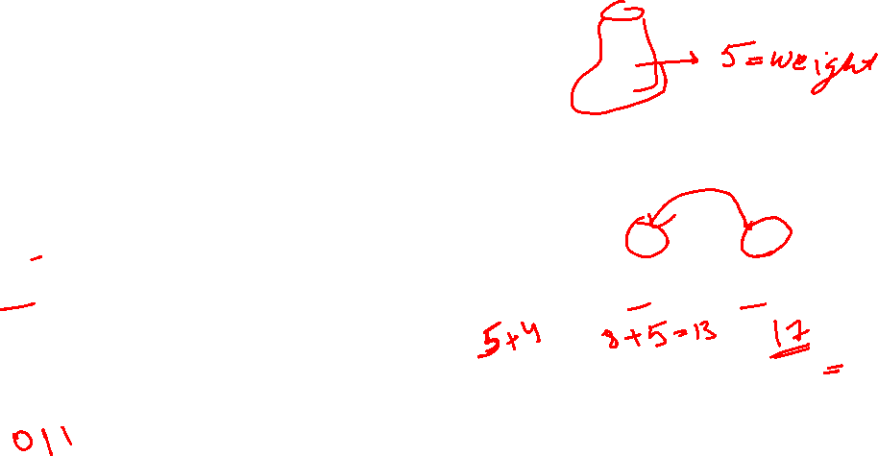
Knapsack problem
Knapsack means a bag
Given: Items with profit and weight
Goal: fill the bag to get maximum profit
Input: Items with weight and profit and maximum capacity of bag
The type of knapsack can be found by the way we fill the bag

Slide 9
Knapsack types
0/1 knapsack
bounded knapsack
unbounded knapsack
Knapsack types
Fractional knapsack
Greedy
Integral knapsack
DP

Slide 10







0/1 Knapsack
Input: items weight(wt[]) and profit(profit[]) and capacity of bag (bag).
Goal: maximize profit by picking elements and filling the bag
Constraint:
Each item can be picked only once.( two possibilities yes/no)
We can't pick more than size of knapsack
Notes:
2^n - recursion

Slide 11


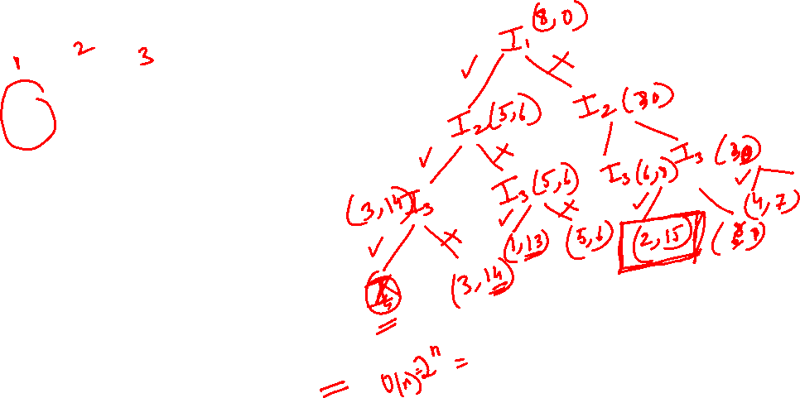


0/1 Knapsack using recursion
Input:
Two choices per item
Total combination: 2*2*2*…2(n times) = 2^n
Notes:
Complexity Analysis:
Time Complexity: O(2^{n}). As there are redundant subproblems.
Auxiliary Space :O(1). As no extra data structure has been used for storing values.

Slide 12








When to chose and skip
Space = total capacity – filled capacity
Base value( where we need to stop) :
min space = 0,
no. of elements left = 0
return type knapsack(input)
{
1. base condition
2. decision tree
}
return type = int -> max profit
Input -> wt[],profit[],space in bag, element number)

Slide 13
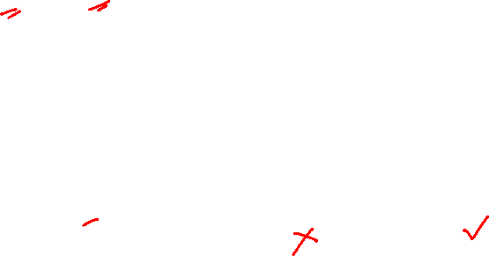
Pseudo code
int knapsack(int wt[], int profit[], int w, int N)
{
if(n==0|| w==0) // base condition
return 0;
if(wt[n]>w) // skip or prune
return knapsack(wt, profit,w,n-1)
else
return max(knapsack(wt,profit,w,n-1),profit[n]+knapsack(wt,profit,w-wt[n],n-1)
}

Slide 14


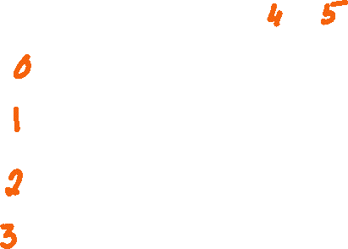

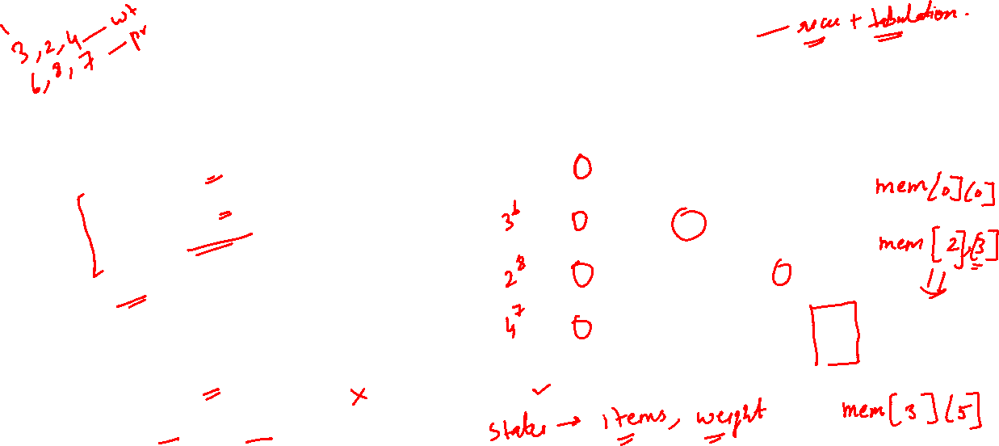
0/1 knapsack using memoization
int knapsack(int wt[], int profit[], int w, int N)
{
if(n==0|| w==0) // base condition
return 0;
if (mem[w][n]!=-1)
return mem[w][n]
int result;
if(wt[n]>w) // skip or prune
result = knapsack(wt, profit,w,n-1)
else
result = max(knapsack(wt,profit,w,n-1),profit[n]+knapsack(wt,profit,w-wt[n],n-1))
return mem[w][n]=result
}
Time complexity O(N.W)
-1 | -1 | -1 | -1 | -1 | -1
-1 | -1 | -1 | -1 | -1 | -1
-1 | -1 | -1 | -1 | -1 | -1
-1 | -1 | -1 | -1 | -1 | -1

Slide 15
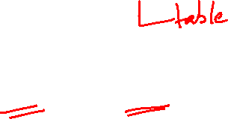
0/1 Knapsack tabulation method
Why tabular method?
Recursion: exponential time
Memoization: function calls(recursion stack ) + table
Tabular method: table
Recursion takes more time than iteration
Stack overflow for large values
How to build table?
Identify no. of states = 2
Space in knapsack(W)
No. of items (N)
dp[W][N]

Slide 16

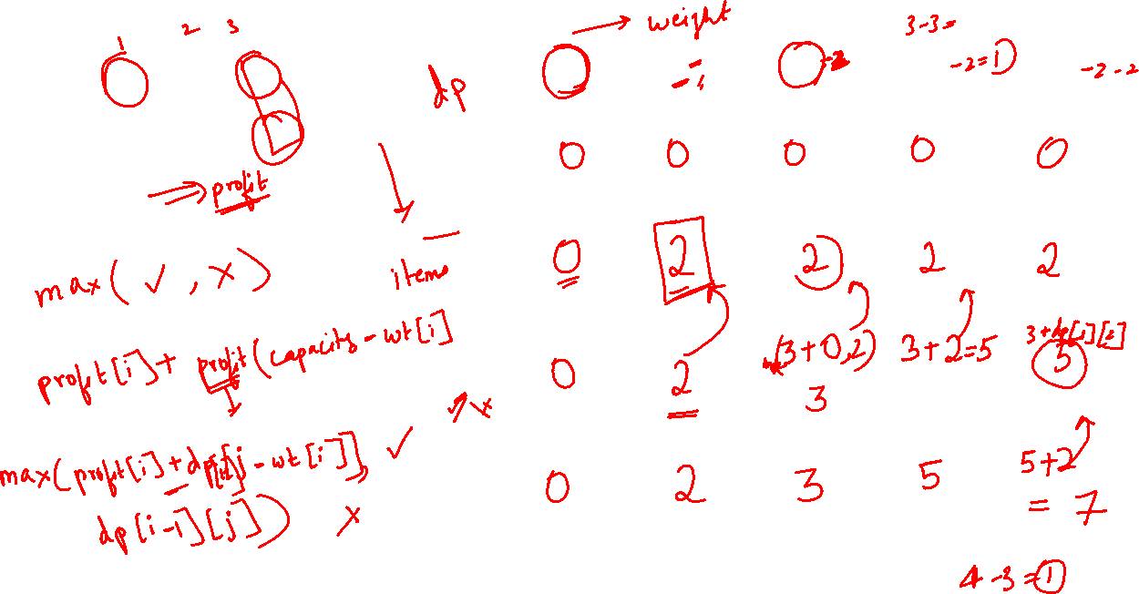


Notes:
Complexity Analysis:
Time Complexity: O(N*W). where ‘N’ is the number of weight element and ‘W’ is capacity. As for every weight element we traverse through all weight capacities 1<=w<=W.
Auxiliary Space: O(N*W). The use of 2-D array of size ‘N*W’.

Slide 18



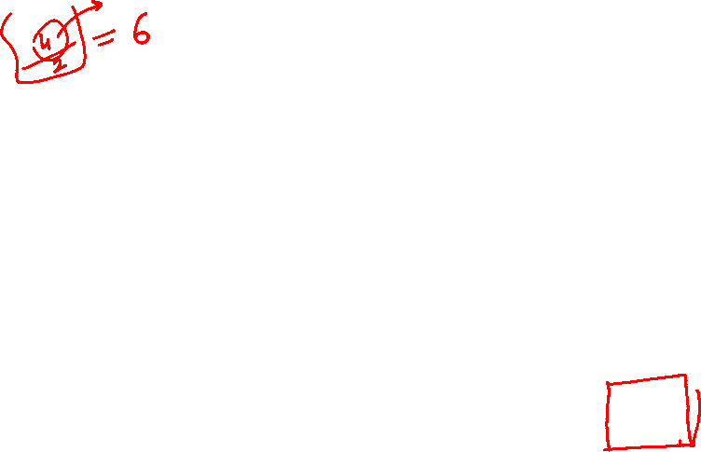

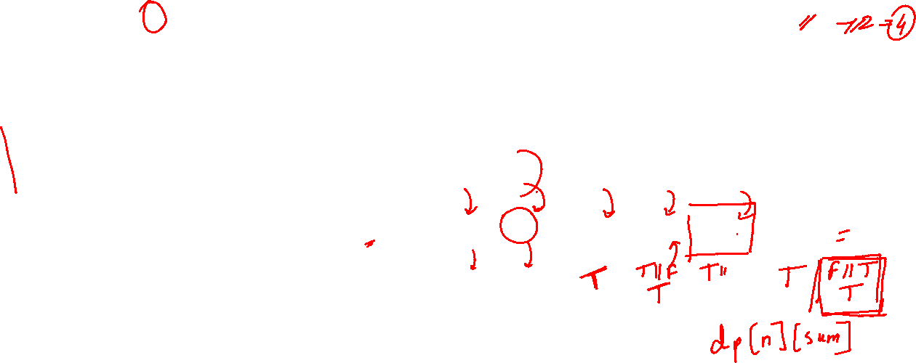
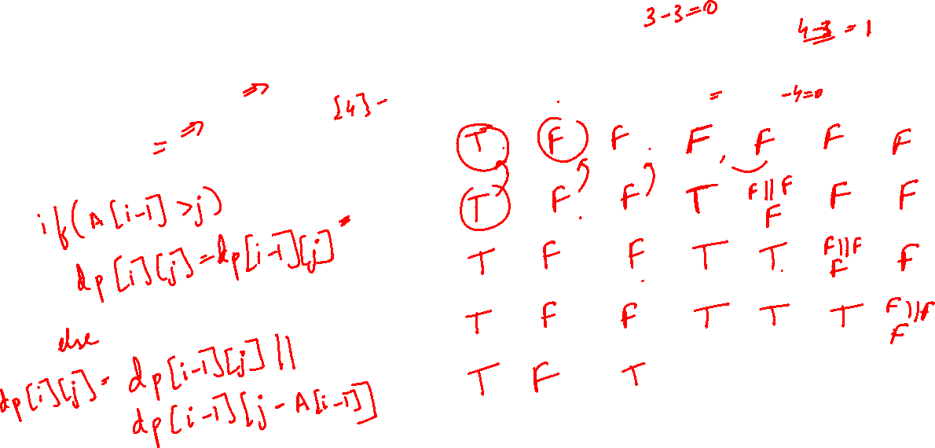
Subset sum
set[]={3, 4, 5, 2} target=6
set[]={3, 4, 5, 2}
target=6

Slide 19
DP problems using 0/1 knapsack
subset sum
partition equal subset sum
count subsets with given sum
minimum subset sum difference
no. of subsets with given difference
target sum

Slide 20
Practice
House robber series on leetcode
https://leetcode.com/problems/house-robber/
https://leetcode.com/problems/house-robber-ii/
https://leetcode.com/problems/house-robber-iii/

Slide 21
Thank you

